Slide 1
ACF Project 2 - Census Data
Berkshire, Franklin, and Hampshire Counties
Bella Davies

Slide 2
Outline
Surveys Analyzed:
B04004 - People Reporting Single Ancestry
B05006 - Place of Birth for the Foreign-Born Population
S0506 - Foreign-Born, Latin America
(no data for these 3 counties)
Each survey is broken down by:
County
Sub County (town)
Ancestry/Place of Birth

Slide 3
B04004 - People Reporting Single Ancestry
The ACS (American Community Survey) asks each respondent to write their ancestry or ethnic origin. The table for People Reporting Single Ancestry (B04004) shows data for those who reported only one ancestry.
From the Census reporter website:
“Ancestry does not necessarily equate with place of birth, as a person can be generations removed from the ancestors they choose to identify with.”
“Some respondents also write ‘American’ as their ancestry for various reasons, whether their ancestors have been in the United States for a long time or they are foreign born but consider themselves part of American society.”

Slide 4
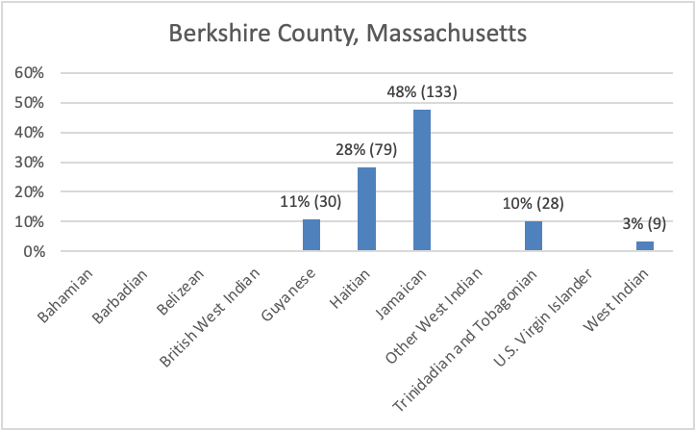
B04004 - People Reporting Single Ancestry
Berkshire County
This figure shows the distribution of single ancestries reported in Berkshire County.
Individuals with Jamaican ancestries make up the largest percentage of the population of individuals with Caribbean ancestry in Berkshire County, at 48% with 133 individuals.
This is followed by Haitian ancestry at 28% and 79 individuals, Guyanese at 11% and 30 individuals, Trinidadian and Tobagonian at 10% and 28 individuals, and West Indian at 3% and 9 individuals.

Slide 5
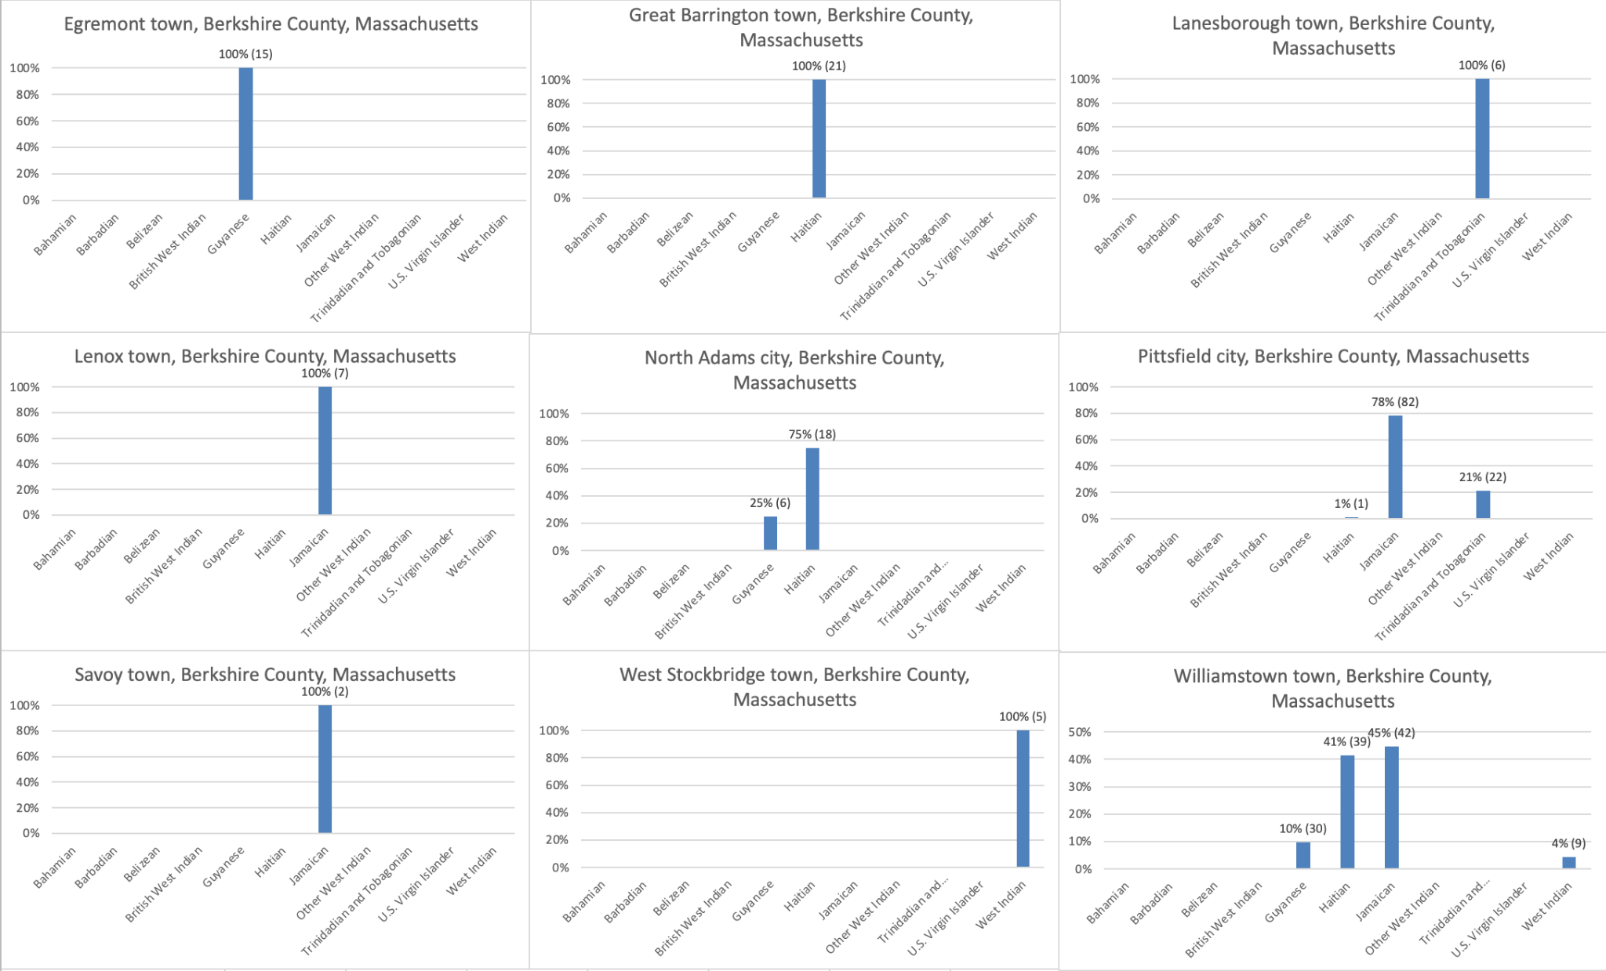
B04004 - People Reporting Single Ancestry
Berkshire Sub Counties (Towns)
This figure shows the distribution of single ancestries reported in different sub counties or towns across Berkshire County.
As seen from the figure, many towns only have one ancestry reported. These towns are Egremont, Great Barrington, Lanesborough, Lenox, Savoy, and West Stockbridge
North Adams is made up of 75% or 18 Haitian ancestries, and 25% or 6 Guyanese ancestries. Pittsfield has 78% or 82 Jamaican ancestries, 21% or 22 Trinidadian or Tobagonian ancestries, and 1% or 1 Haitian Ancestry. Williamstown is mostly made up of Jamaican and Haitian ancestries at 45% (42 individuals) and 41% (39 individuals. The remaining 14% is made up of Guyanese and West indian ancestries.

Slide 6
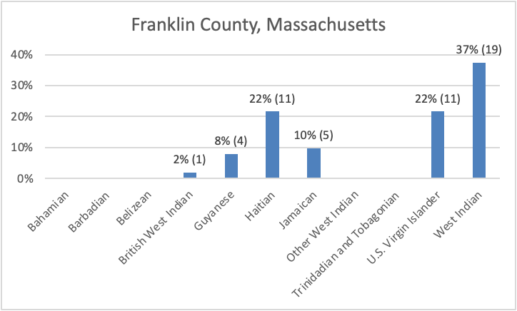
B04004 - People Reporting Single Ancestry
Franklin County
This figure shows the distribution of single ancestries reported in Franklin County.
Individuals with West Indian ancestries make up the largest percentage of the population of individuals with Caribbean ancestry in Franklin County, at 37% with 19 individuals.
This is followed by Haitian and US Virgin Islander ancestries at 22% or 11 individuals each.
Jamaican ancestries make up 10% or 5 individuals, and the remaining 10% is made up of Guyanese ancestries at 8% or 4 individuals, and British West Indian ancestries at 2% or 1 individual.

Slide 7
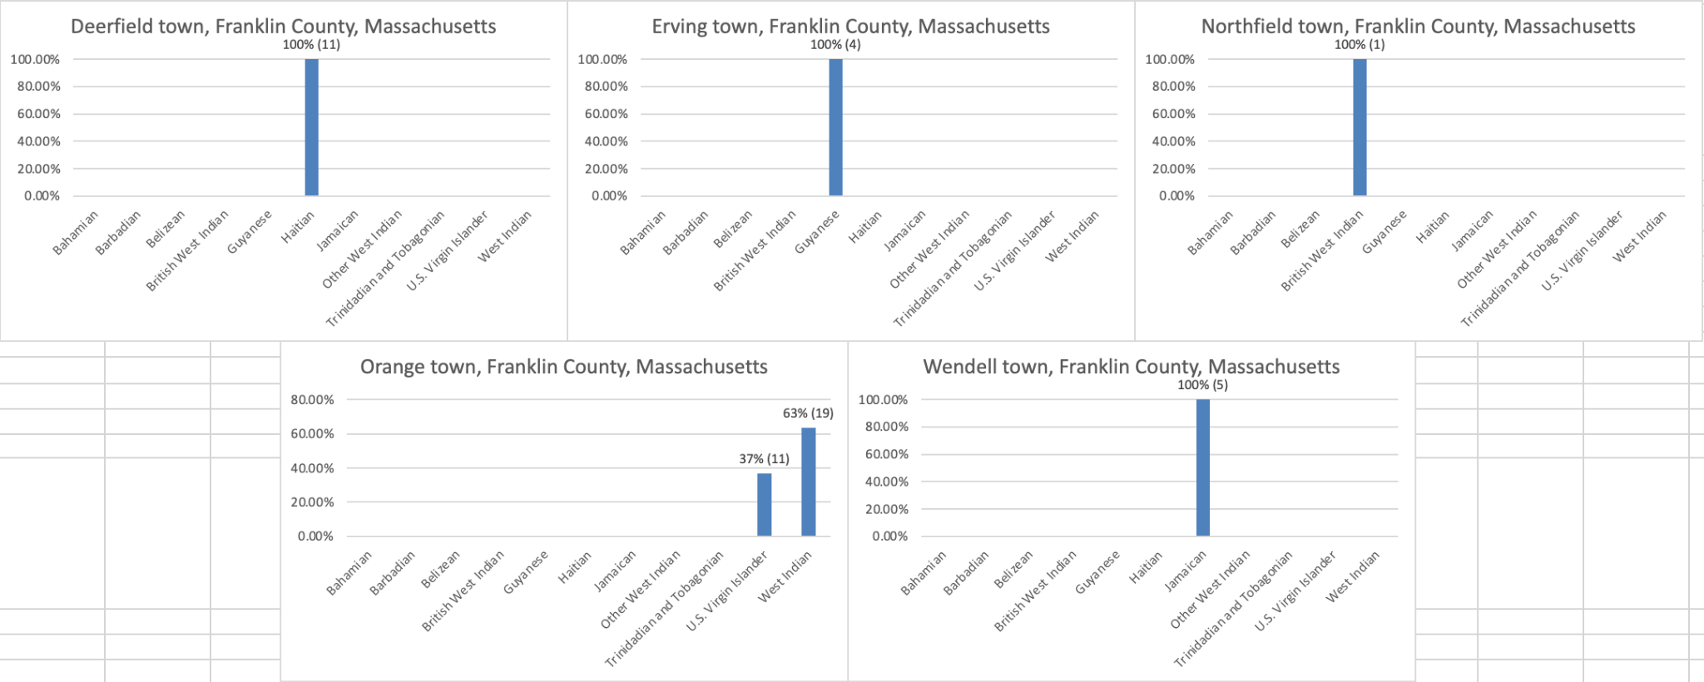
B04004 - People Reporting Single Ancestry
Franklin Sub Counties (Towns)
This figure shows the distribution of single ancestries reported in different sub counties or towns across Franklin County.
Deerfield has 11 reported Haitian ancestries, while Erving has 4 Guyanese ancestries, Northfield has 1 British West Indian ancestries, and Wendell has 5 Jamaican ancestries.
Orange town is made up of 63% or 19 individuals of West Indian ancestry, and 37% or 11 individuals of US Virgin Islander ancestry.

Slide 8
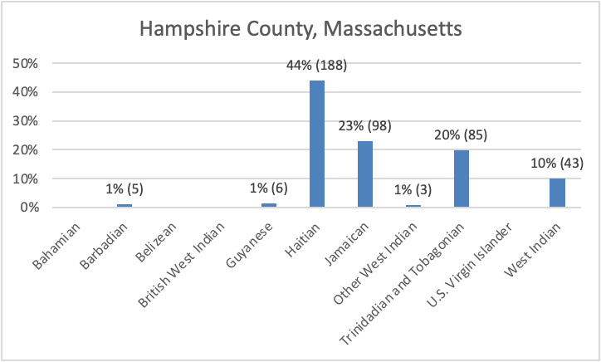
B04004 - People Reporting Single Ancestry
Hampshire County
This figure shows the distribution of single ancestries reported in Hampshire County.
Individuals with Haitian ancestries make up the largest percentage of the population of individuals with Caribbean ancestry in Hampshire County, at 44% with 188 individuals.
This is followed by Jamaican ancestries at 23% with 98 individuals, and Trinidadian and Tobagonian at 20% with 85 individuals.
West Indian ancestries make up 10% with 43 individuals, and the remaining 3% is spread across Barbadian, Guyanese, and Other West Indian ancestries with 5, 6, and 3 individuals respectively.

Slide 9
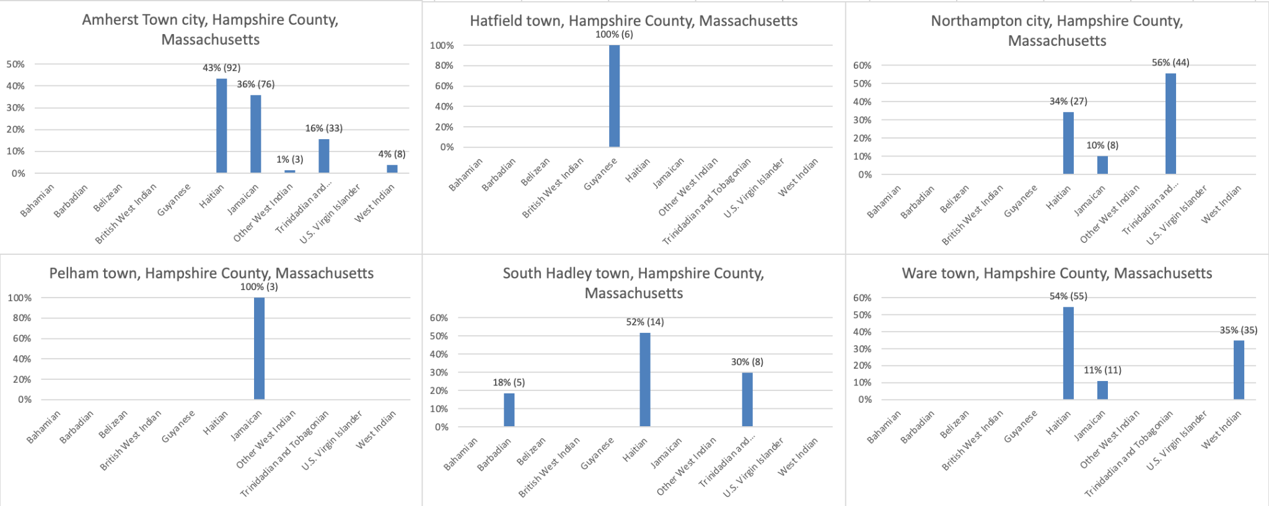
B04004 - People Reporting Single Ancestry
Hampshire Sub Counties (Towns)
This figure shows the distribution of single ancestries reported in different sub counties or towns across Hampshire County.
In Amherst, Haitian ancestries make up the largest percentage at 43% with 92 individuals, followed by Jamaican ancestries with 36% and 76 individuals.
In South Hadley and Northampton, there are Haitian ancestries, with 52% or 14 individuals in South Hadley, and 34% or 27 individuals in North Hampton. These two towns also have Trinidadian and Tobagonian ancestries, with 30% or 8 individuals in South Hadley, and 56% or 44 individuals in Northampton. South Hadley also has 18% or 5 individuals of Barbadian ancestry, and Northampton has 10% or 8 individuals of Jamaican ancestry.
Ware has 54% or 55 individuals with Haitian ancestries, and 35% or 35 individuals of West Indian ancestry. The remaining 11% is made up of 11 individuals of Jamaican ancestry
Hatfield has 6 reported Guyanese ancestries while Pelham has 1 reported Jamaican ancestry.

Slide 10
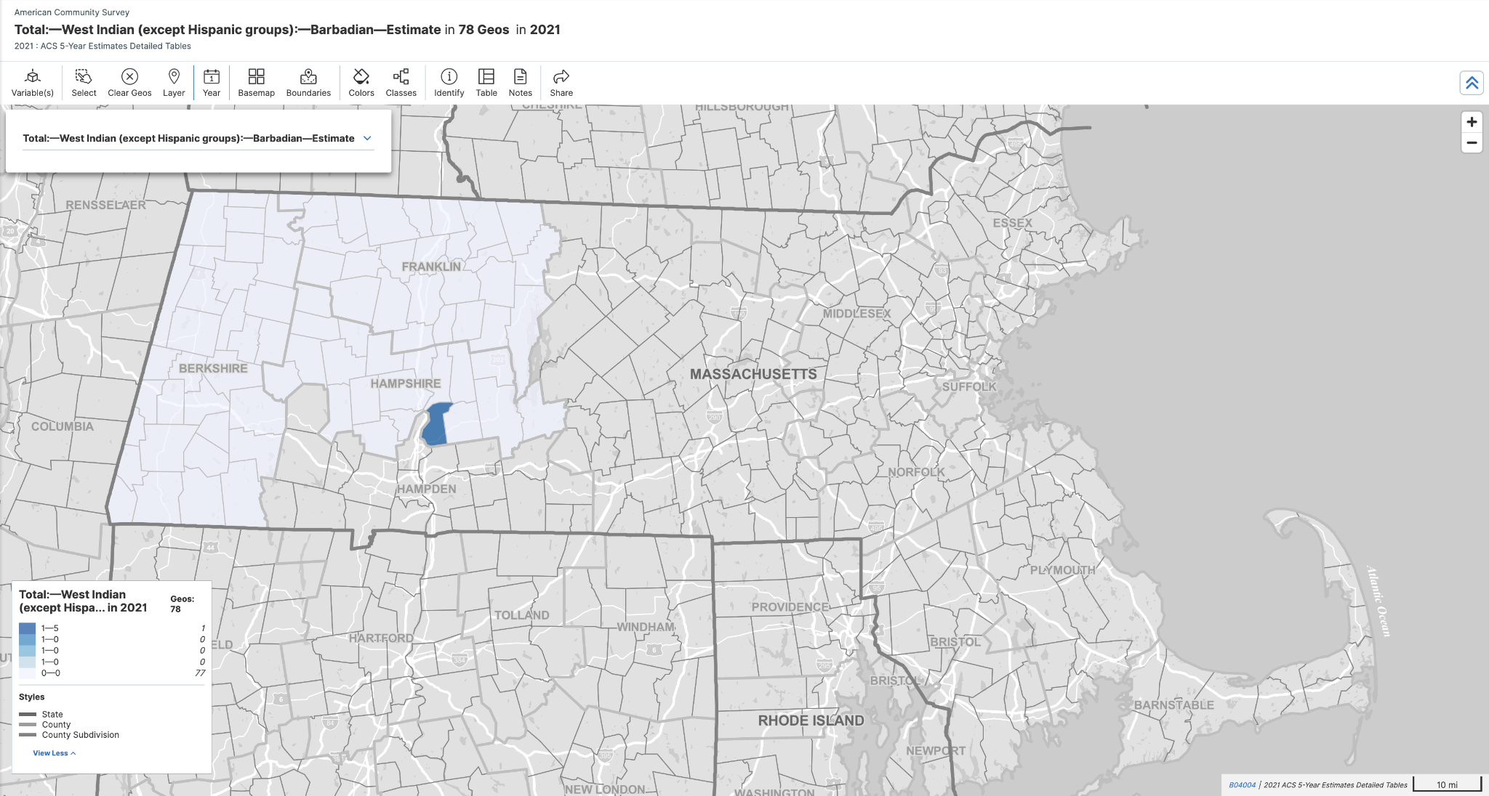
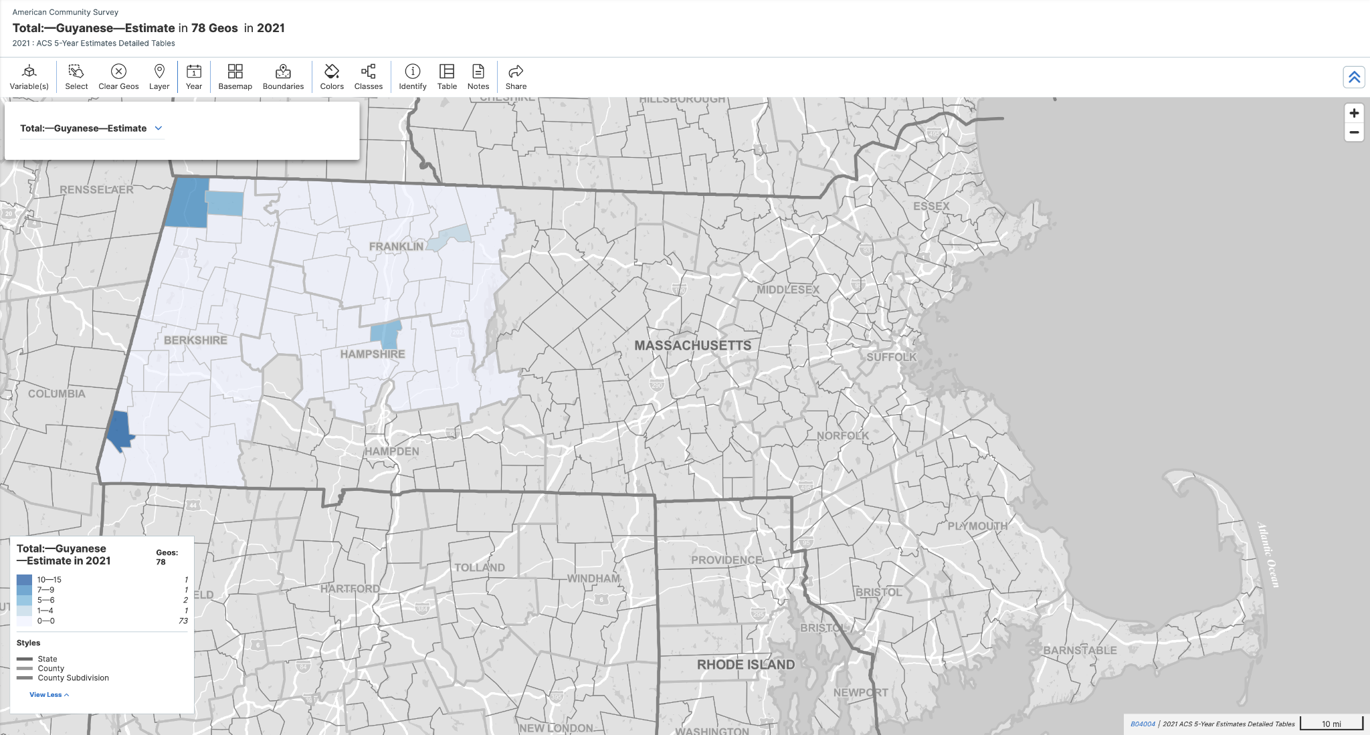
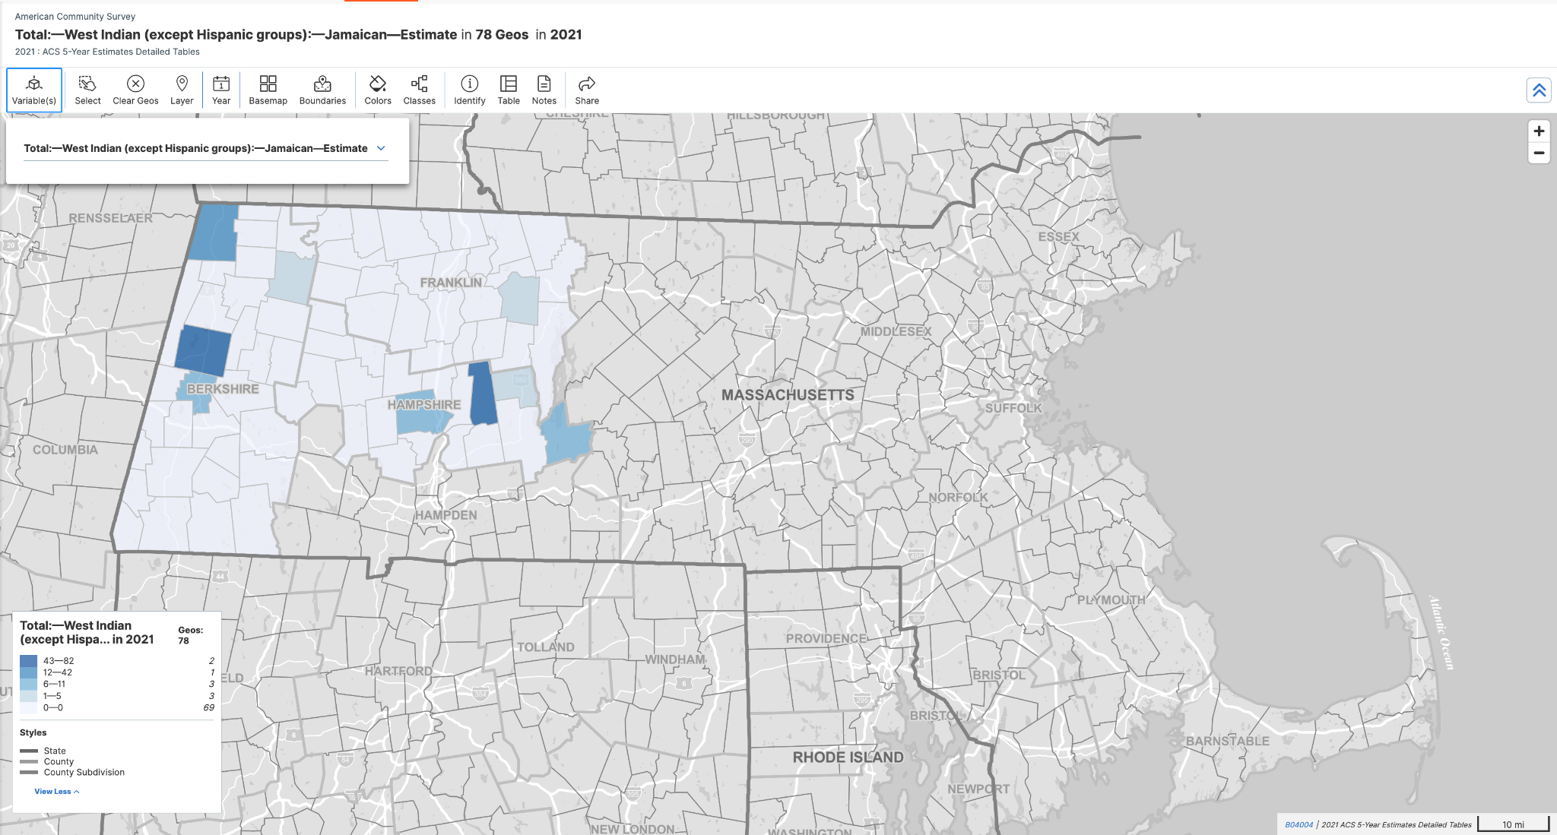
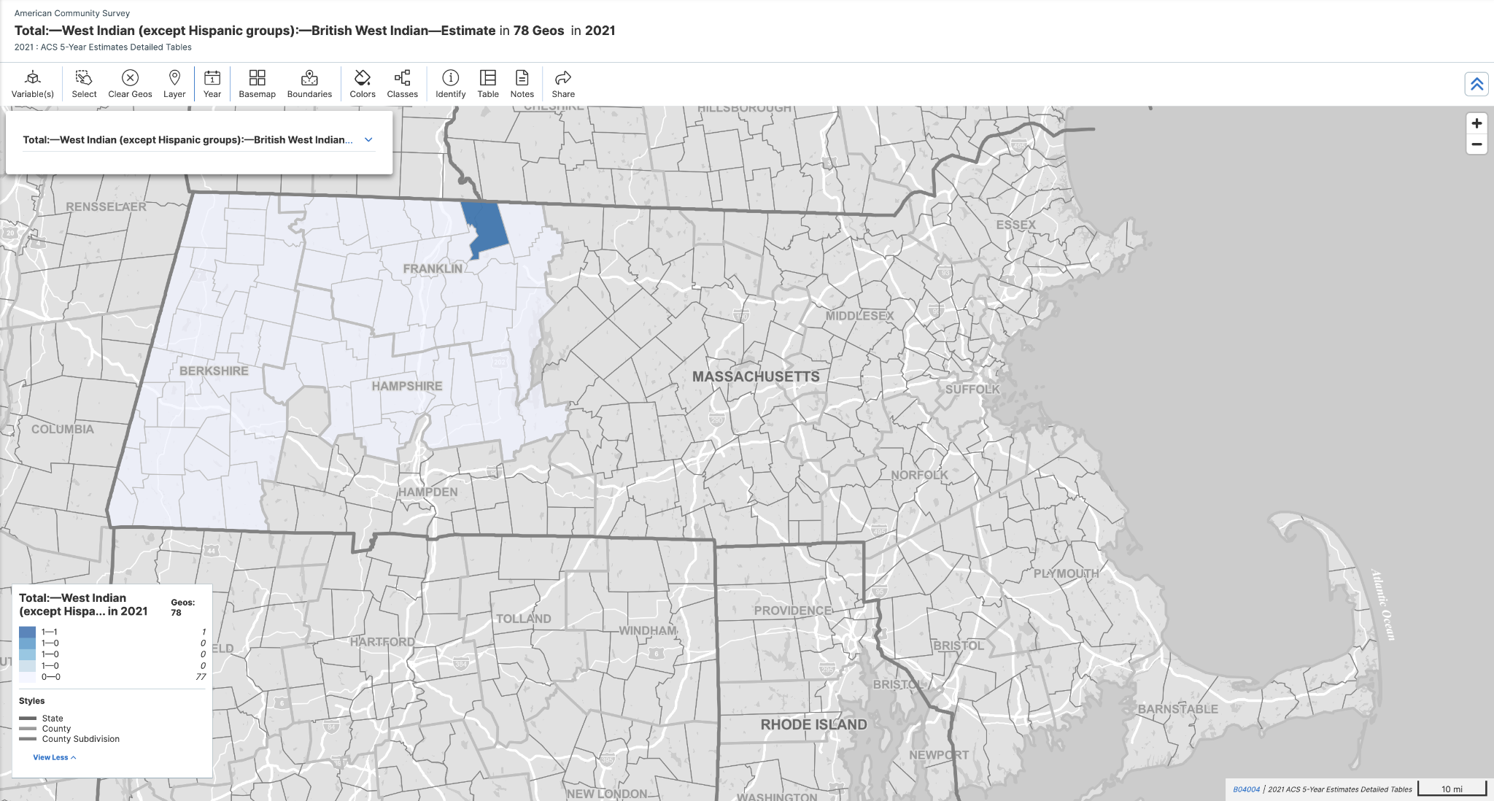
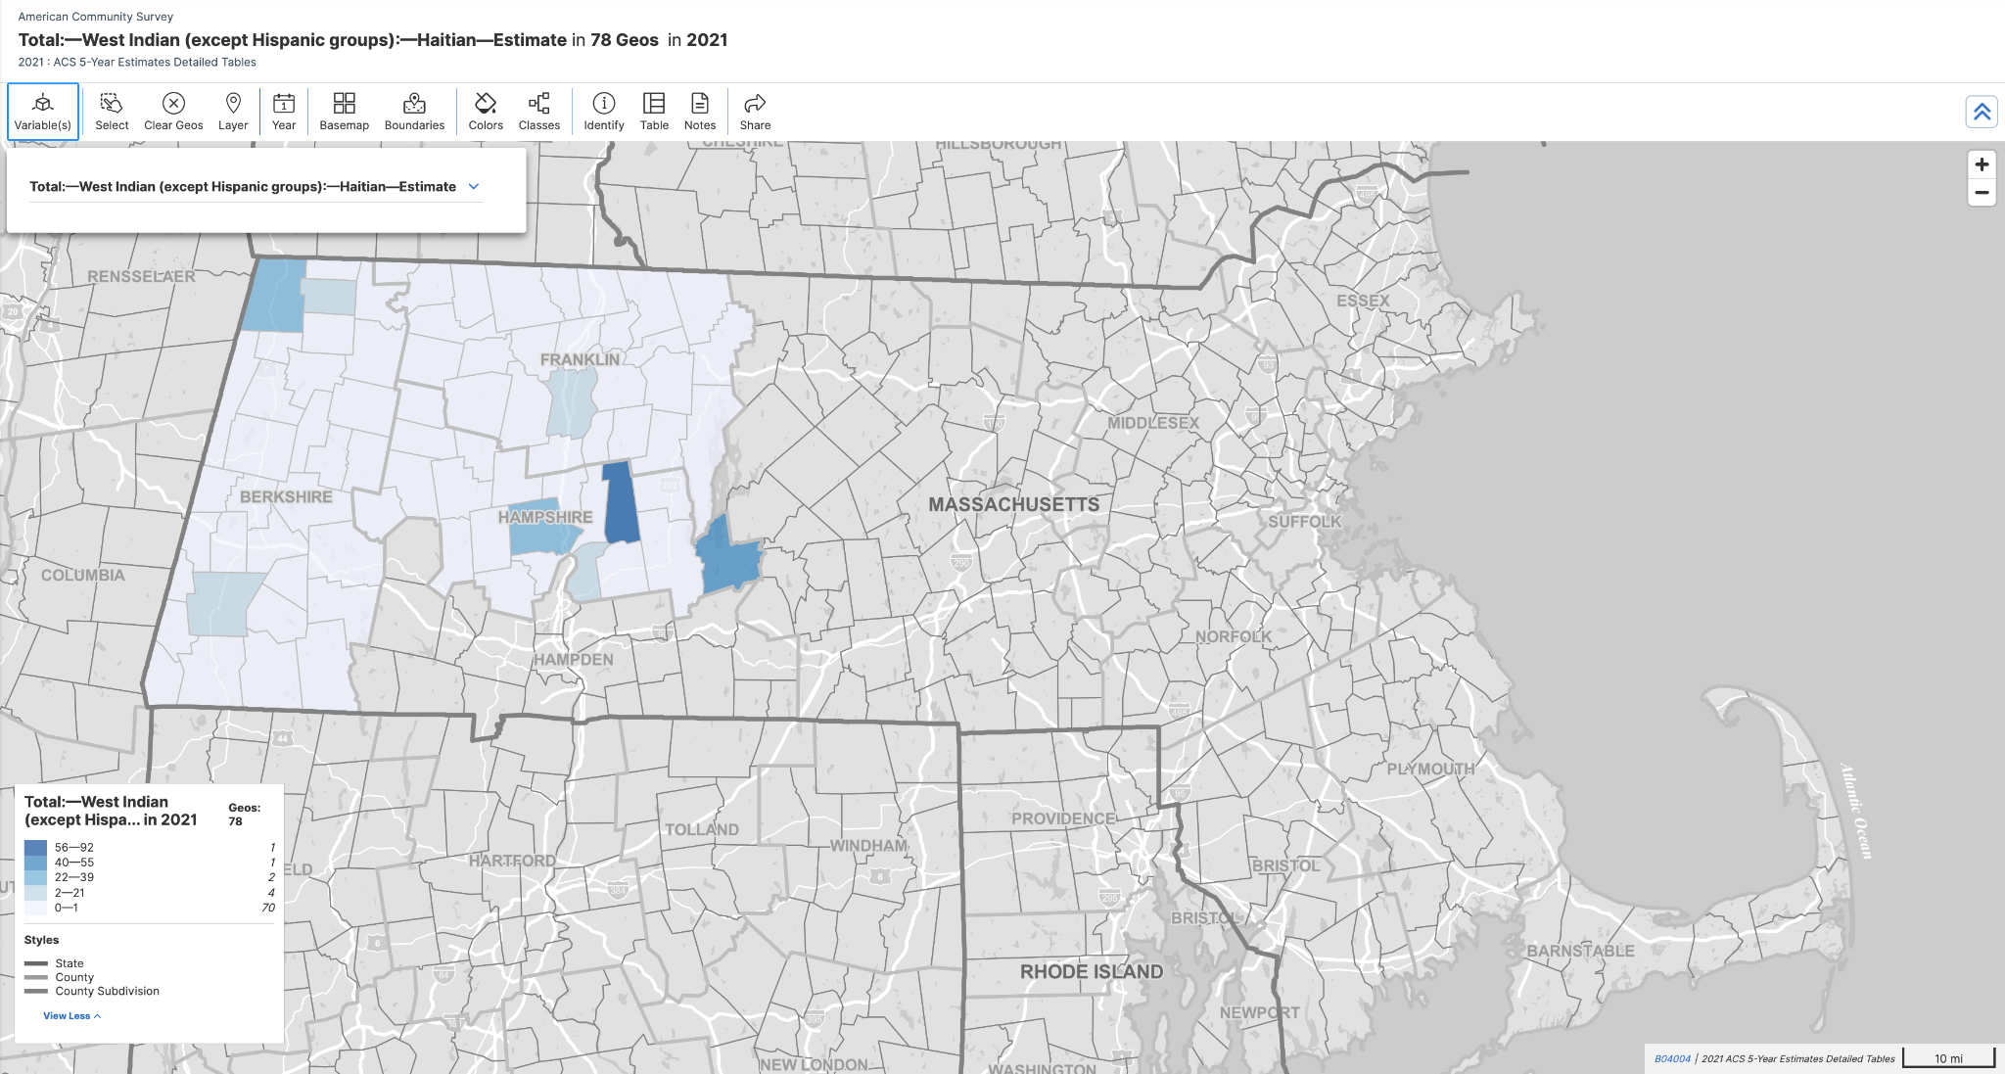
B04004 - People Reporting Single Ancestry
(Pt. 1 of 2. Distribution of Ancestries Across All Sub Counties or Towns within
Berkshire, Franklin, and Hampshire)

Slide 11
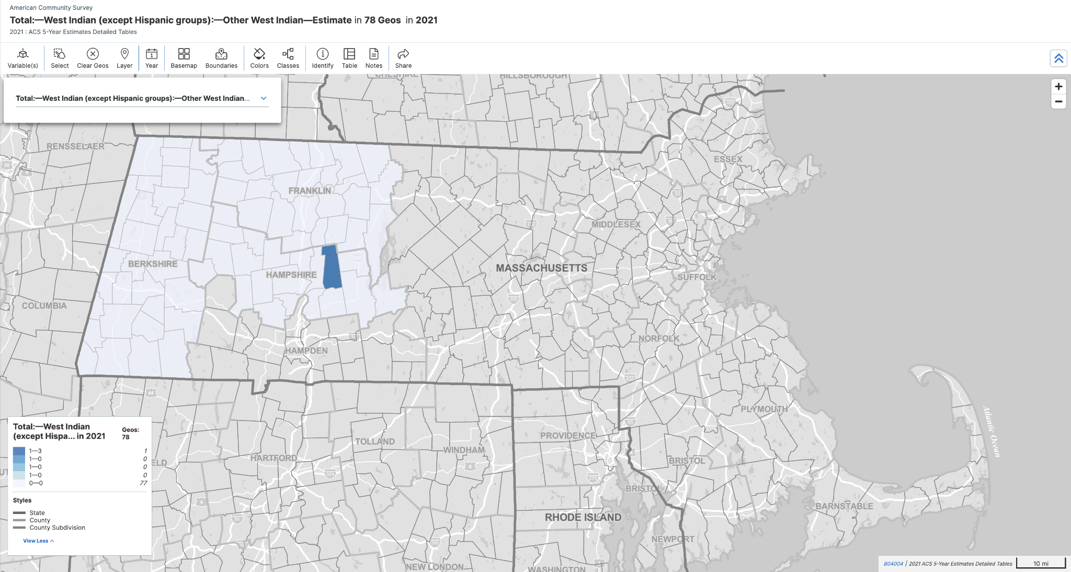
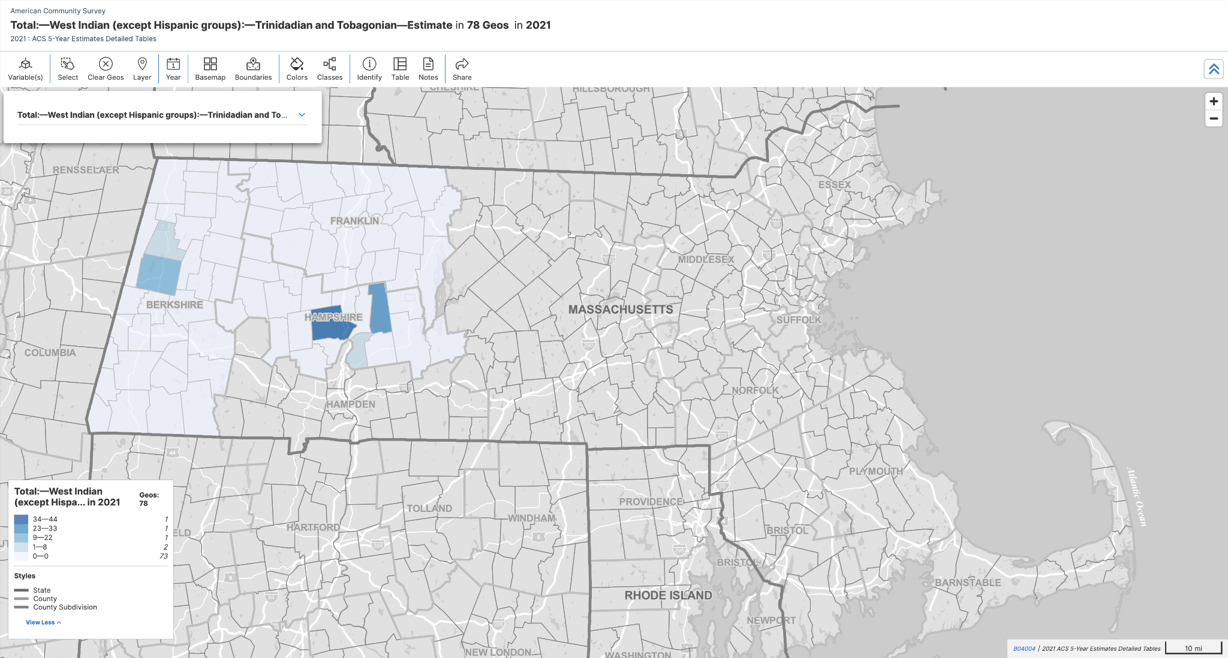
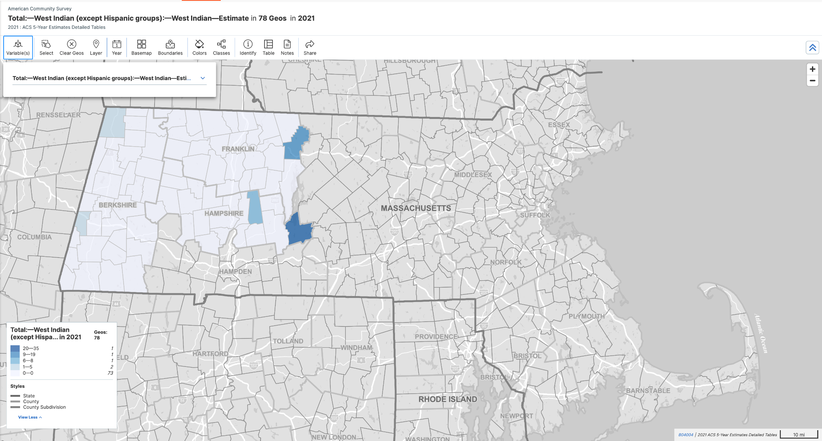
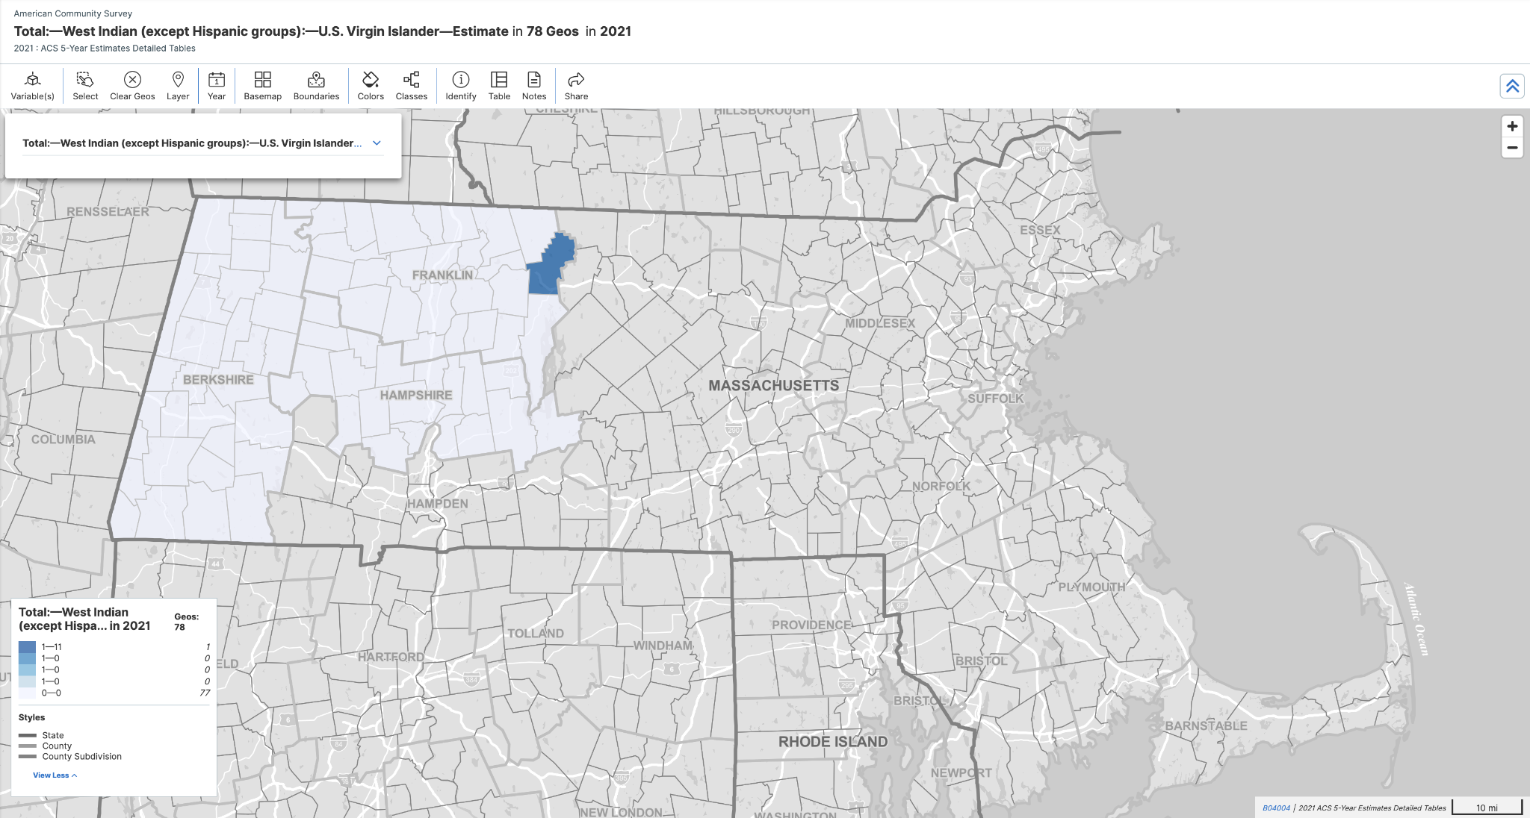
B04004 - People Reporting Single Ancestry
(Pt. 2 of 2. Distribution of Ancestries Across All Sub Counties or Towns within
Berkshire, Franklin, and Hampshire)

Slide 12
B05006 - Place of Birth for the Foreign-Born Population
From the Census Reporter website:
Separately from asking about citizenship, the ACS (American Community Survey) asks about each person the location of their birth, be it a state in the U.S. or another country.
A person who is born in the U.S., Puerto Rico, American Samoa, Guam, the Commonwealth of the Northern Mariana Islands, or the US Virgin Islands is "native," as well as those born in a foreign country who have at least one parent who is a U.S. citizen.
People who are not "native" are classified as "foreign born," and may be either a "naturalized citizen" or not a citizen.

Slide 13
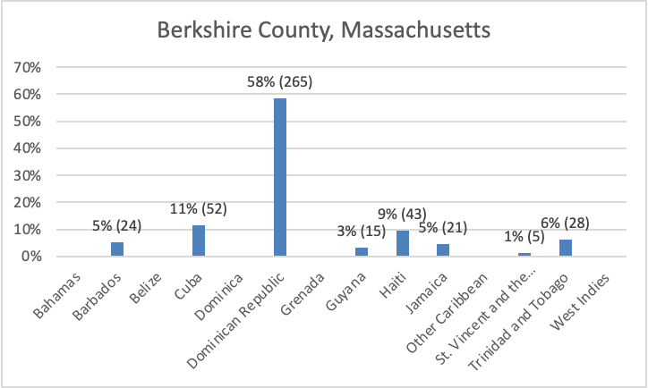
B05006 - Place of Birth for the Foreign-Born Population
Berkshire County
This figure shows the distribution of places of birth for the foreign born population reported in Berkshire.
Individuals born in the Dominican Republic make up the largest percentage at 58% with 265 individuals.
11% or 52 individuals were born in Cuba, followed by 9% or 43 individuals born in Haiti, and 6% or 28 individuals born in Trinidad and Tobago.
The remaining 14% is spread across individuals born in Barbados (5% or 24 individuals), Jamaica (5% or 21 individuals), Guyana (3% or 15 individuals), and St. Vincent and the Grenadines (1% or 5 individuals).

Slide 14
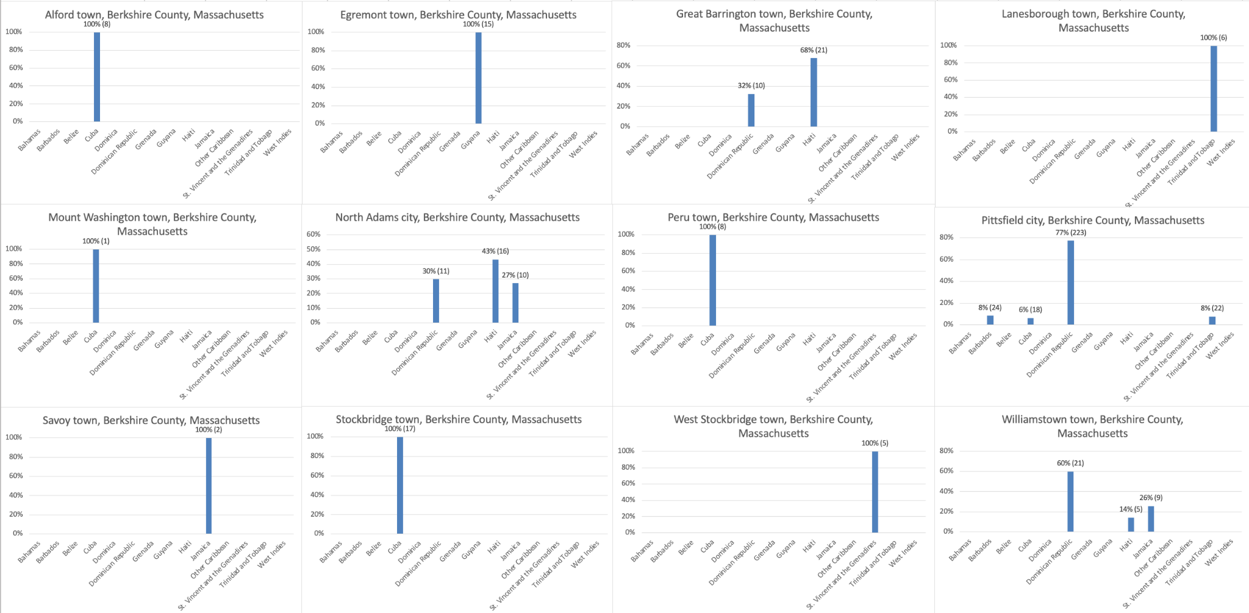
B05006 - Place of Birth for the Foreign-Born Population
Berkshire Sub Counties (Towns)
This figure shows the distribution of places of birth for the foreign-born population in different sub counties or towns across Berkshire County.
Some key observations from this figure are that Pittsfield has 223 individuals born in the Dominican Republic, and that across all other towns in Berkshire, people born in Cuba, Haiti, and Jamaica have the highest percentages.

Slide 15
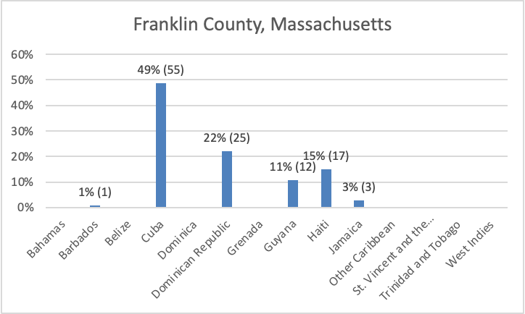
B05006 - Place of Birth for the Foreign-Born Population
Franklin County
This figure shows the distribution of places of birth for the foreign born population reported in Franklin.
Individuals born in Cuba make up the largest percentage at 49% with 55 individuals.
This is followed by 22% or 25 individuals born in the Dominican Republic, 15% or 17 individuals born in Haiti, and 11% or 12 individuals born in Guyana.
The remaining 4% is spread across individuals born in Barbados (1% or 1 individual), and Jamaica (3% or 3 individuals).

Slide 16
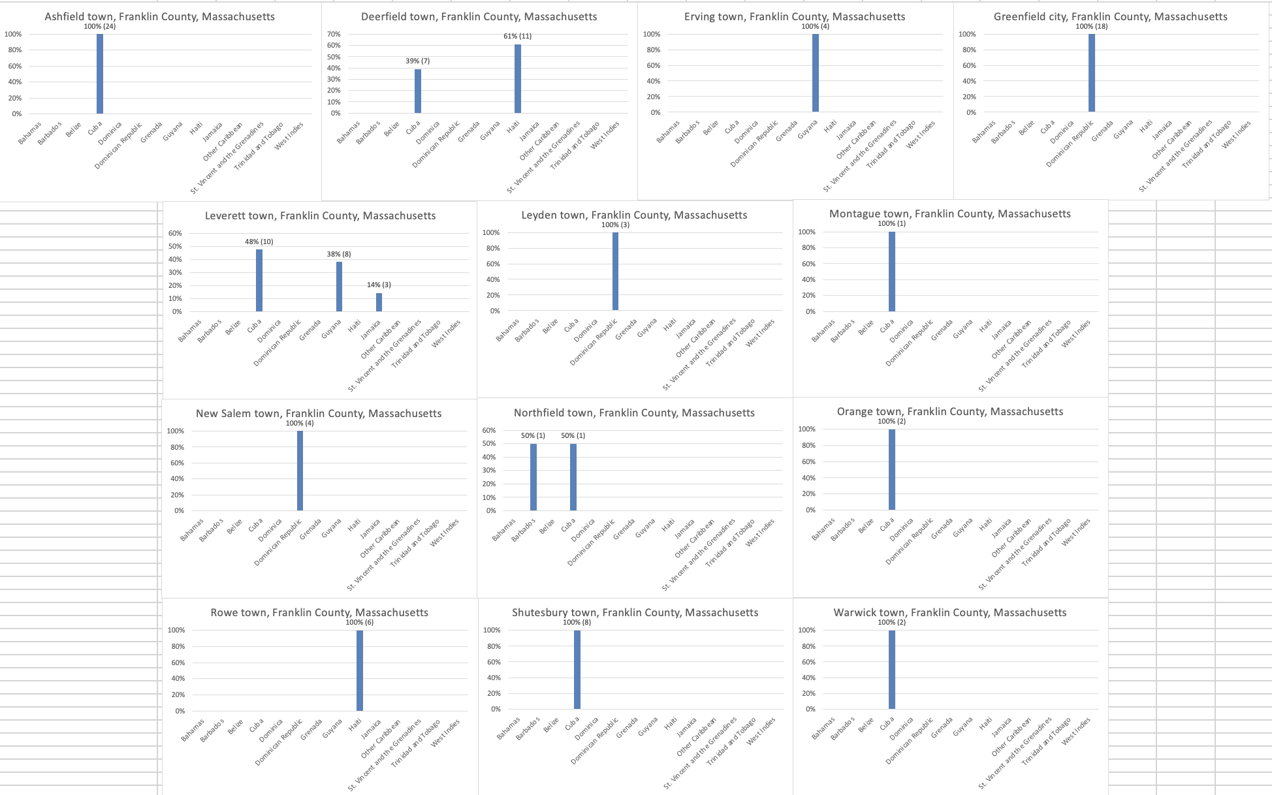
B05006 - Place of Birth for the Foreign-Born Population
Franklin Sub Counties (Towns)
This figure shows the distribution of places of birth for the foreign-born population in different sub counties or towns across Franklin County.
A key observations from this figure are that Ashfield, Montague, Orange, Shutesbury, and Warwick all only have recorded data for people born in Cuba.
Additionally, Greenfield, Leyden, and New Salem all only have recorded data for people born in the Dominican Republic

Slide 17
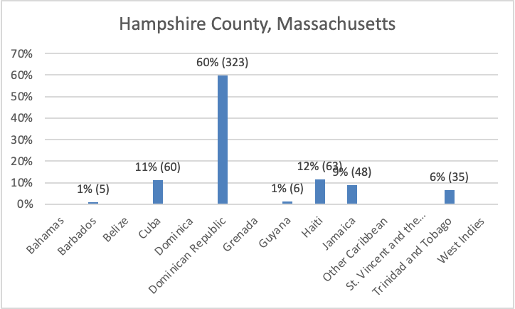
B05006 - Place of Birth for the Foreign-Born Population
Hampshire County
This figure shows the distribution of places of birth for the foreign born population reported in Hampshire.
Individuals born in the Dominican Republic make up the largest percentage at 60% with 323 individuals.
This is followed by 12% or 63 individuals born in the Haiti, 11% or 60 individuals born in Cuba, and 9% or 48 individuals born in Jamaica.
The remaining 8% is spread across individuals born in Trinidad and Tobago (6% or 35 individuals), Guyana (1% or 6 individuals), and Barbados (1% or 5 individuals).

Slide 18
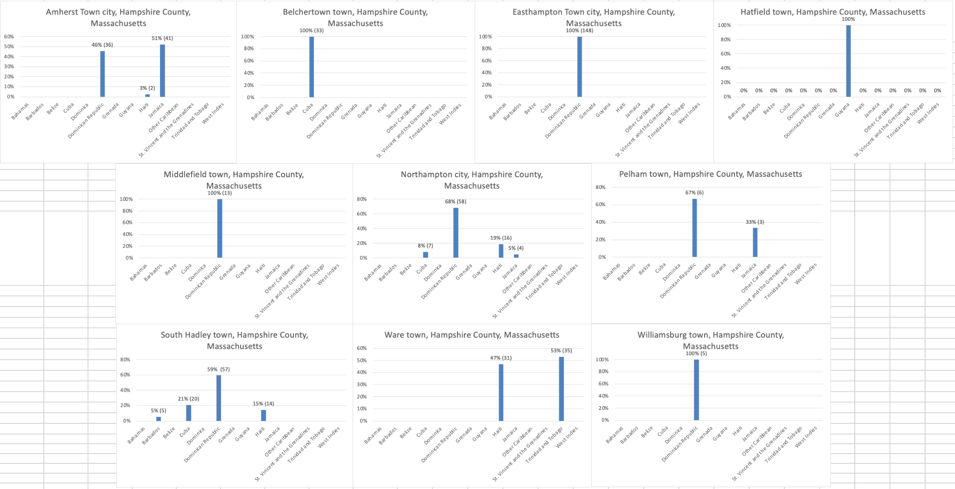
B05006 - Place of Birth for the Foreign-Born Population
Hampshire Sub Counties (Towns)
This figure shows the distribution of places of birth for the foreign-born population in different sub counties or towns across Franklin County.
A key observations from this figure are that Easthampton, Middlefield, and Williamsburg all only have recorded data for people born in the Dominican Republic.
Amherst and Pelham both have people born in Dominican Republic (46% and 67%) and Jamaica (51% and 33%).
Amherst also has 3% or 2 individuals reported to be born in Haiti, while Northampton has 19% with 16 individuals, Waretown has 47% with 31 individuals, and South Hadley has 15% with 14 individuals.

Slide 19
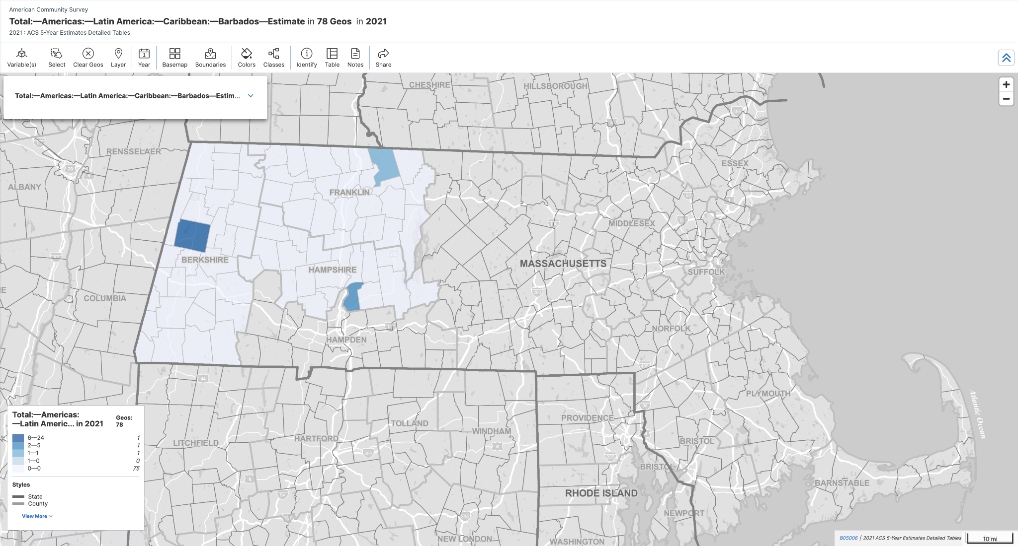
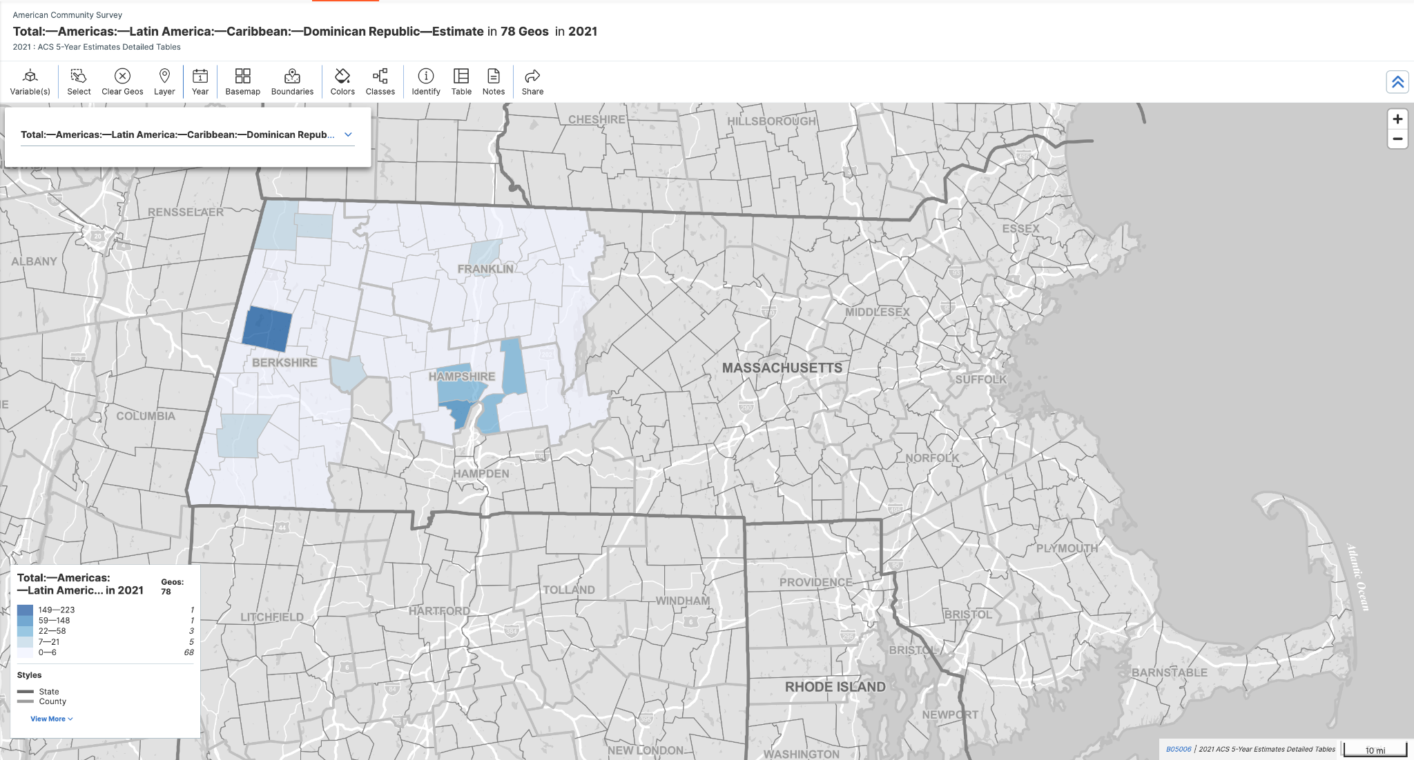
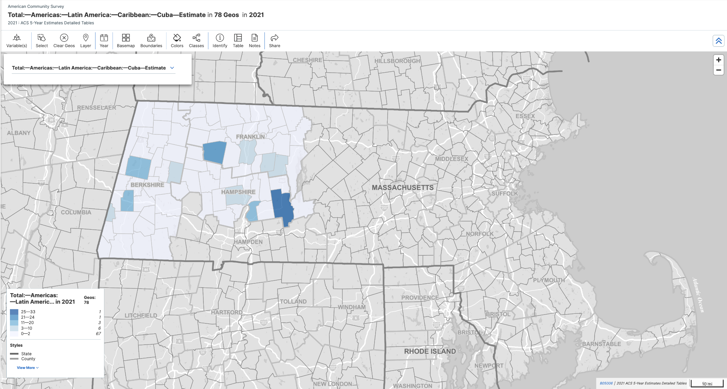
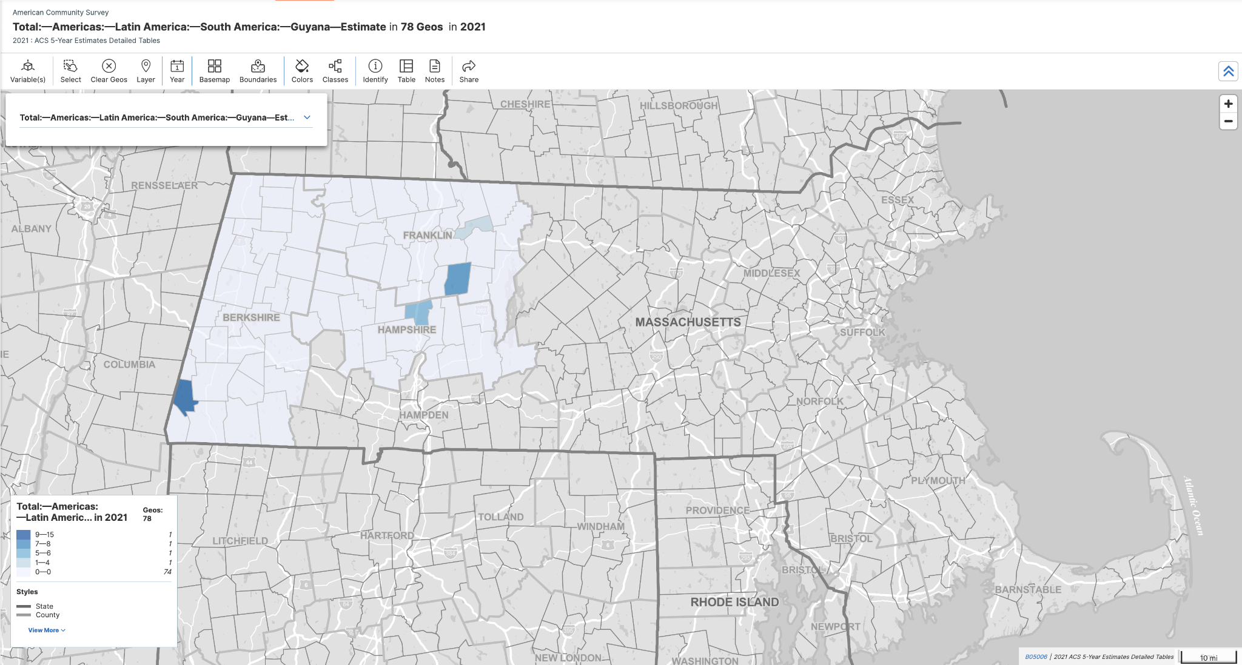
B05006 - Place of Birth for the Foreign-Born Population
(Pt. 1 of 2. Distribution of Countries of Birth Across All Sub Counties or Towns within
Berkshire, Franklin, and Hampshire)

Slide 20
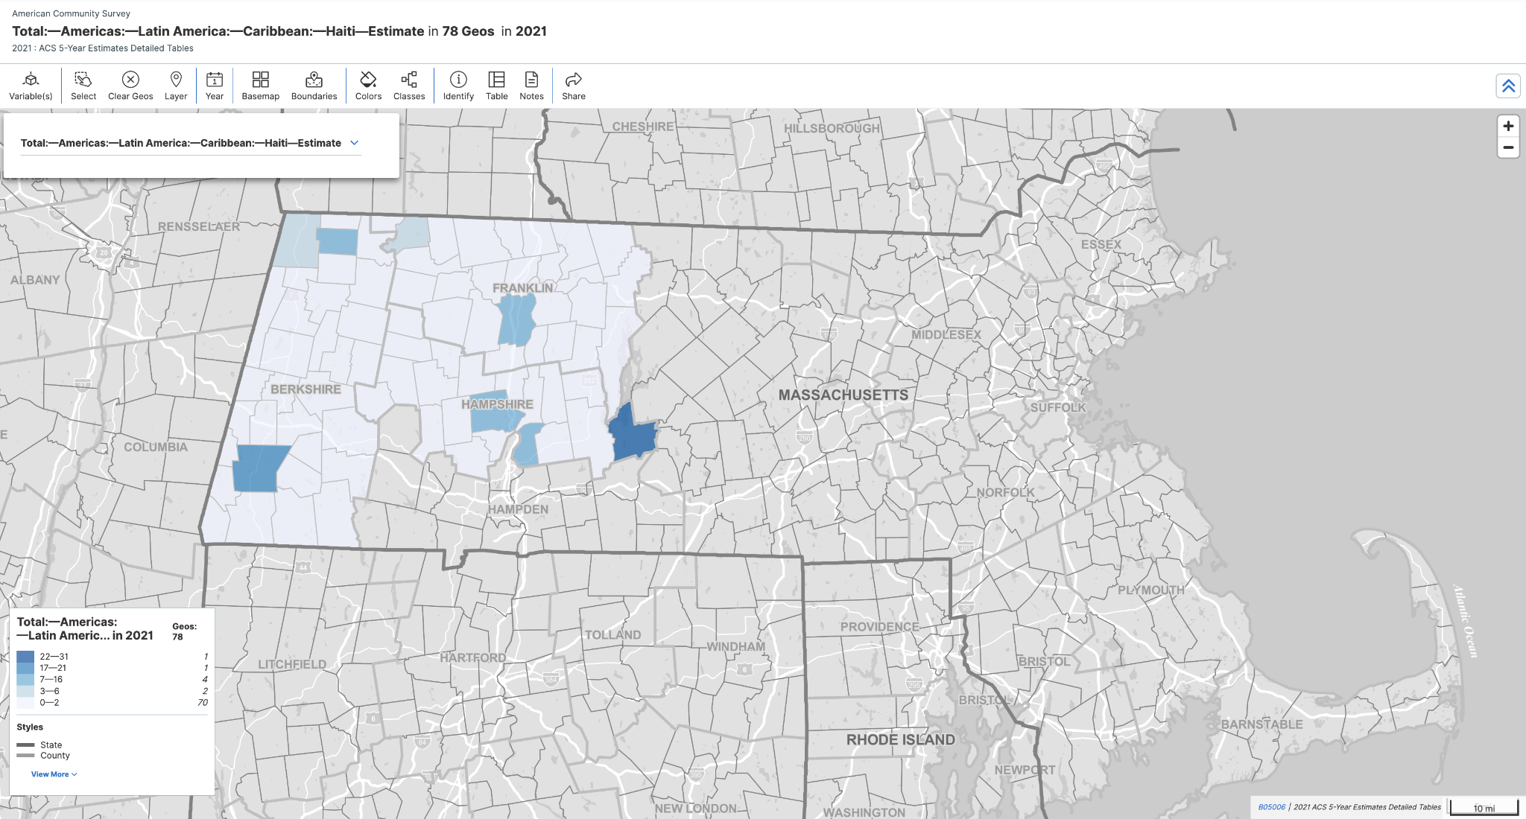
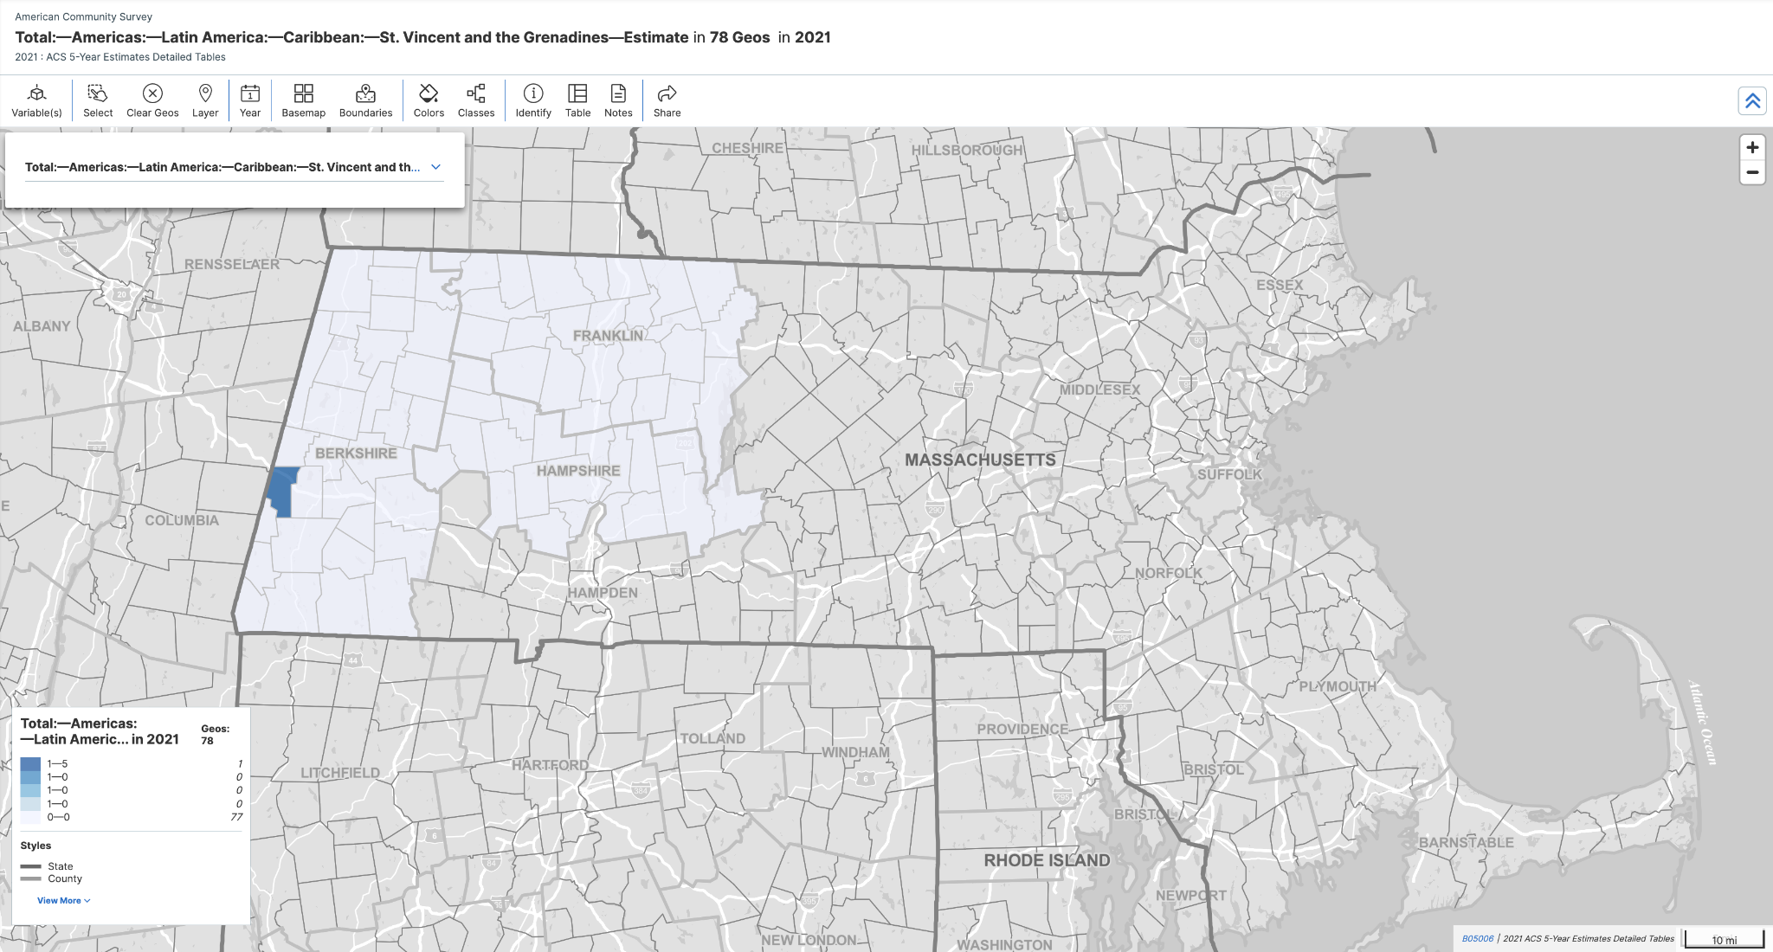
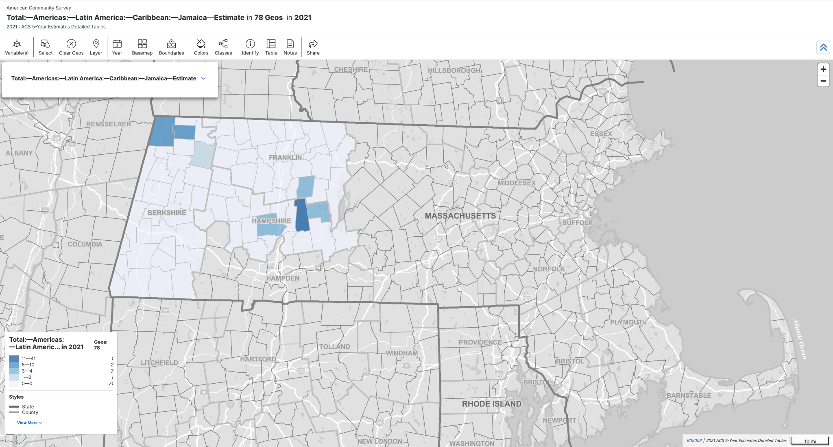
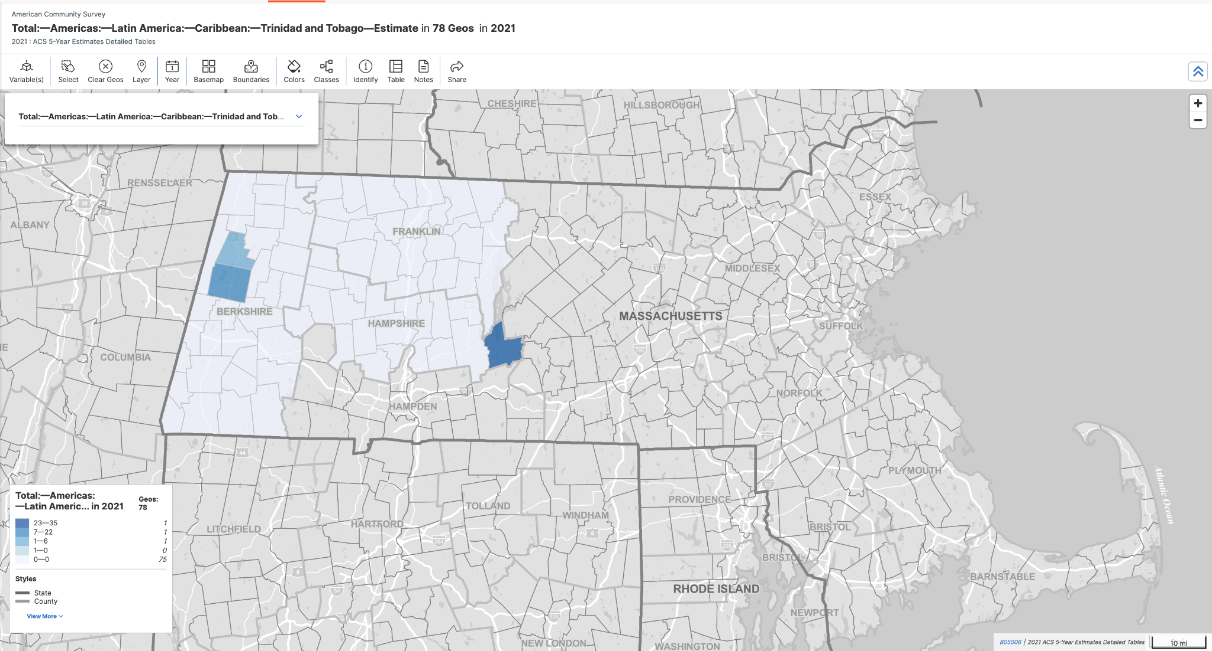
B05006 - Place of Birth for the Foreign-Born Population
(Pt. 2 of 2. Distribution of Countries of Birth Across All Sub Counties or Towns within
Berkshire, Franklin, and Hampshire)

Slide 21
S0506 - Foreign-Born, Latin America
There was no Census data for Berkshire, Franklin, or Hampshire for this survey S0506 - Foreign-Born Latin America, because there was not enough data reported in these counties.

